Slide 1

POWER
FOCUS ON THE WHY?
If you’re not having fun with what
you’re doing then you’re doing it
Wrong.

Slide 2
Woman spend much more than man PPL spend the fewest on kids all segements buy 2+ sizes opens and clicks are variant small(0.065, 0.009) range of hhincome=8052 range of age=3.5 hhwom>>hhmen (1st – 1st =0.6) wom_dept_buy>>man_dept_buy (1st-1st =0.36) man_dept_buy== kids_dept_buy athletic_dept_buy> wom_dept_buy (1st – 1st = 0.052)

Slide 3
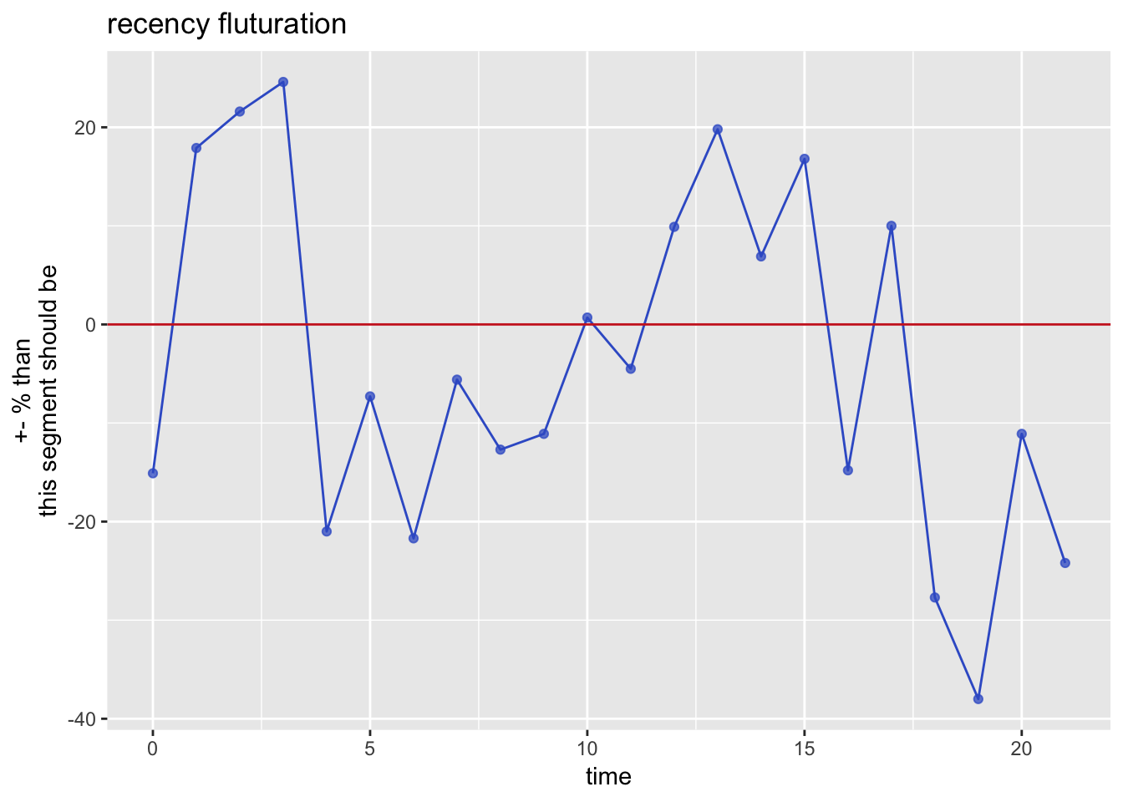
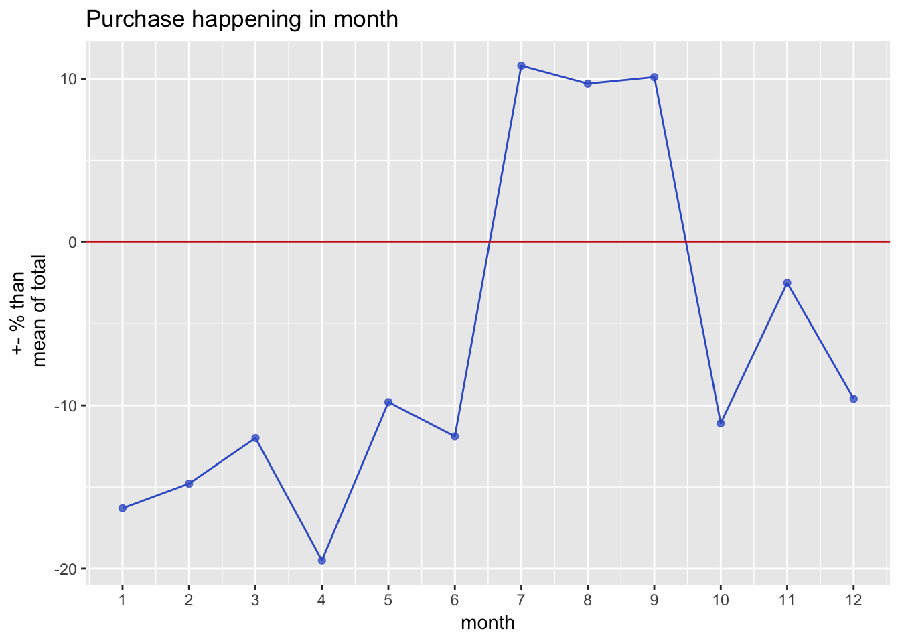
Seg1: 21.8% size , 21.64% revshare, Summer Fling
Other
Mean in %
Response-15.3
internet_spend-37.4
Cmpns-12.2
All
normality in %
recency.1+17.9 recency.2+21.6
recency.3+24.6
recency.4-21 tenure.2+50.5
tenure.9-20.5
Summer buyer,
youngest(30.3),
3rd hhkid,
1st spend avg,
1st recency,

Slide 4
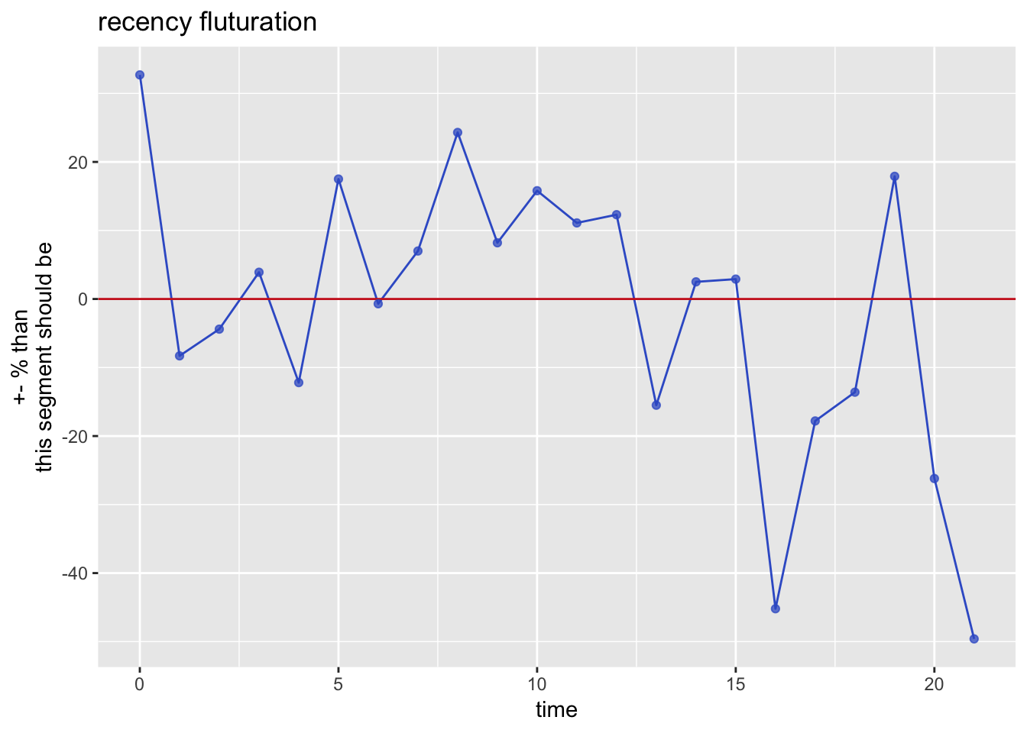
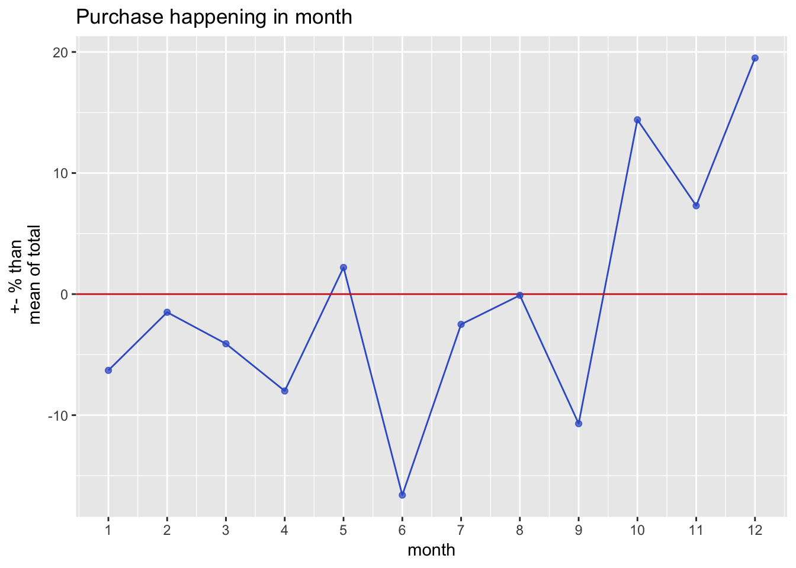
Seg2: 10.9%, 10.85% revshare, Mad Christmas
Month mean In %
Jun-16.6
Sep-10.7
Oct+14.4
Dec+19.5
All
normality in %
recency.0+32.7 recency.2-12.2
recency.16-45.2
recency.4-21
Other
Mean in %
mens_dept_spend+13.3
kids_dept_spend-15
internet_spend+74.9
man_dept_buy+19.3
2nd spend avg,
2nd men_dept_spend,
2nd woman_dept_spend,
2nd recency
1st internet spend(1.21)

Slide 5
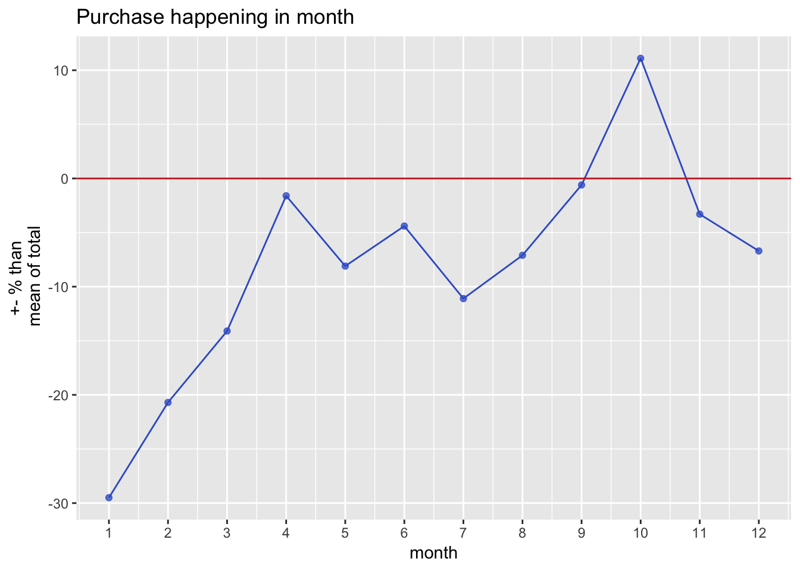
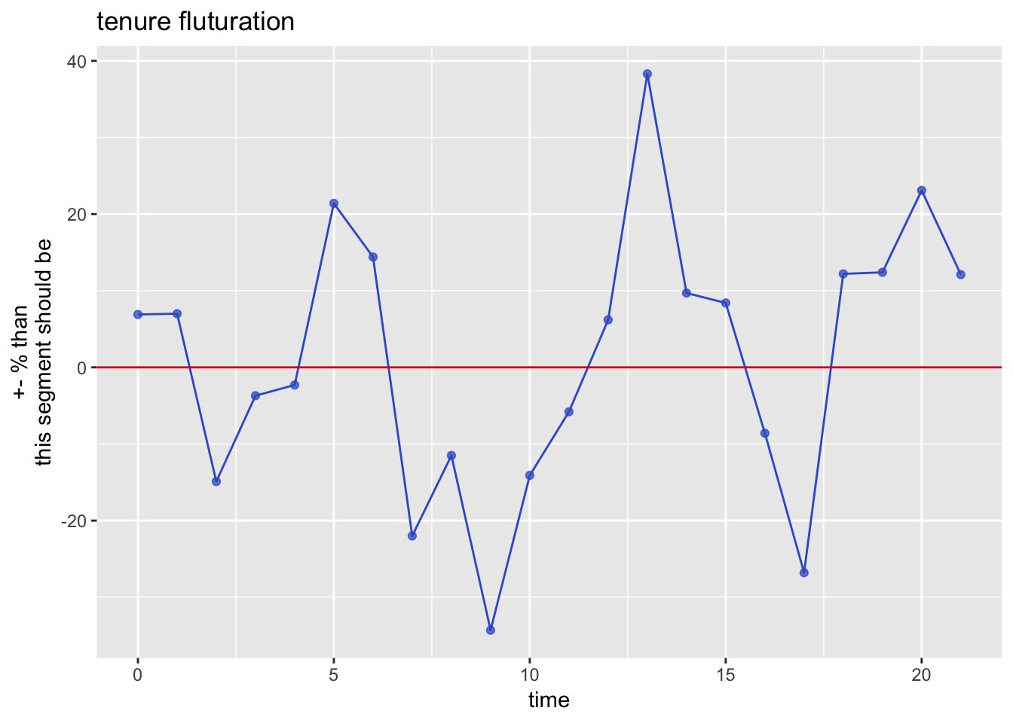
Seg3: 9.8% size, 8.86% revshare Daddy Daycare/ house husband
Month mean In %
Jan-29.5
feb-20.7
Oct+11.1
Other
Mean in %
womens_dept_spend -11.7
athletic_dept_spend -18.4
internet_spend-28.2
cmpns -11.7
retained_flag-13.1
pct_response-19.6
All
normality in %
2nd hhkid, 1st man_dept,

Slide 6
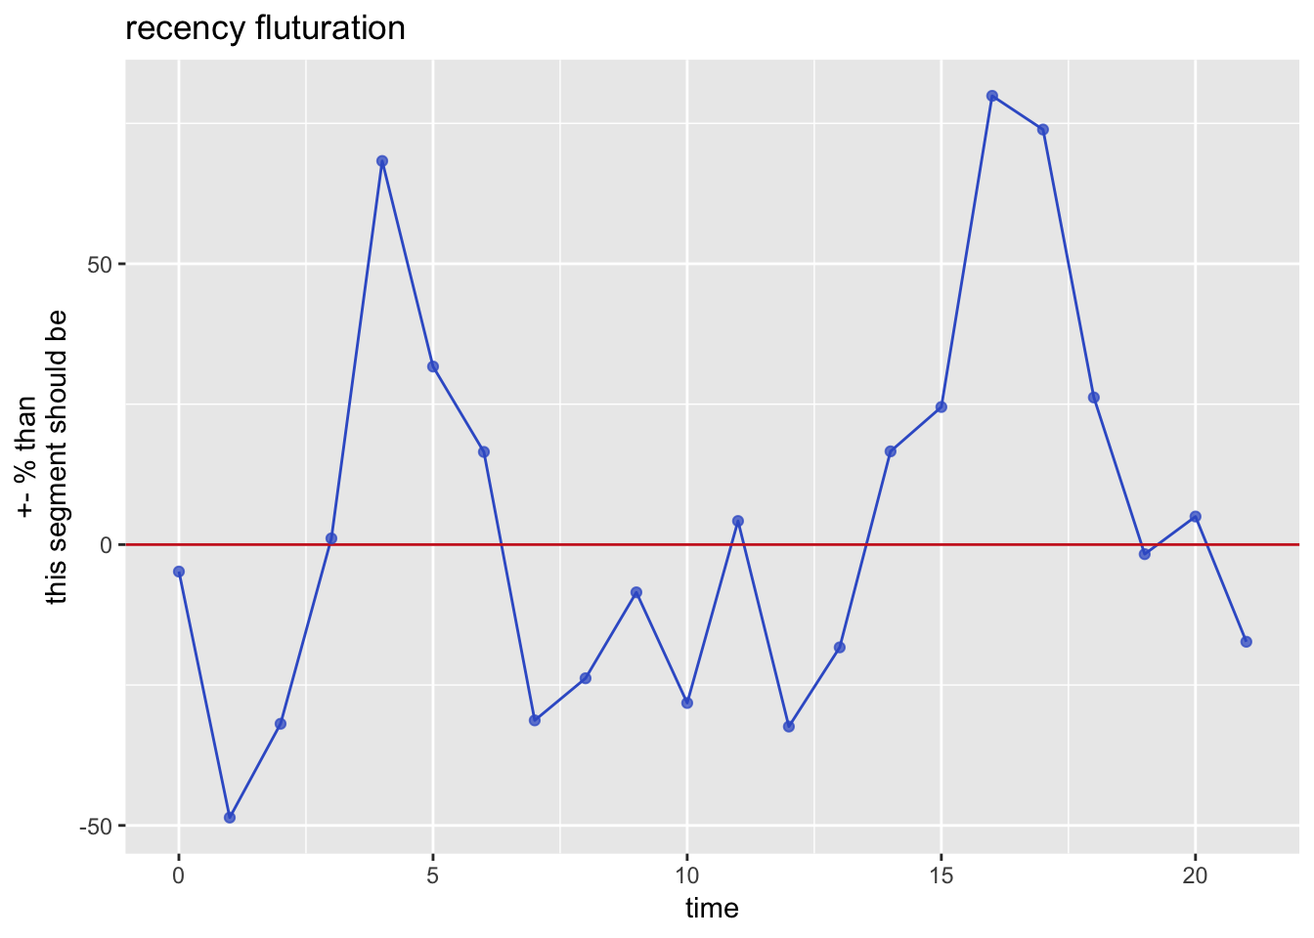
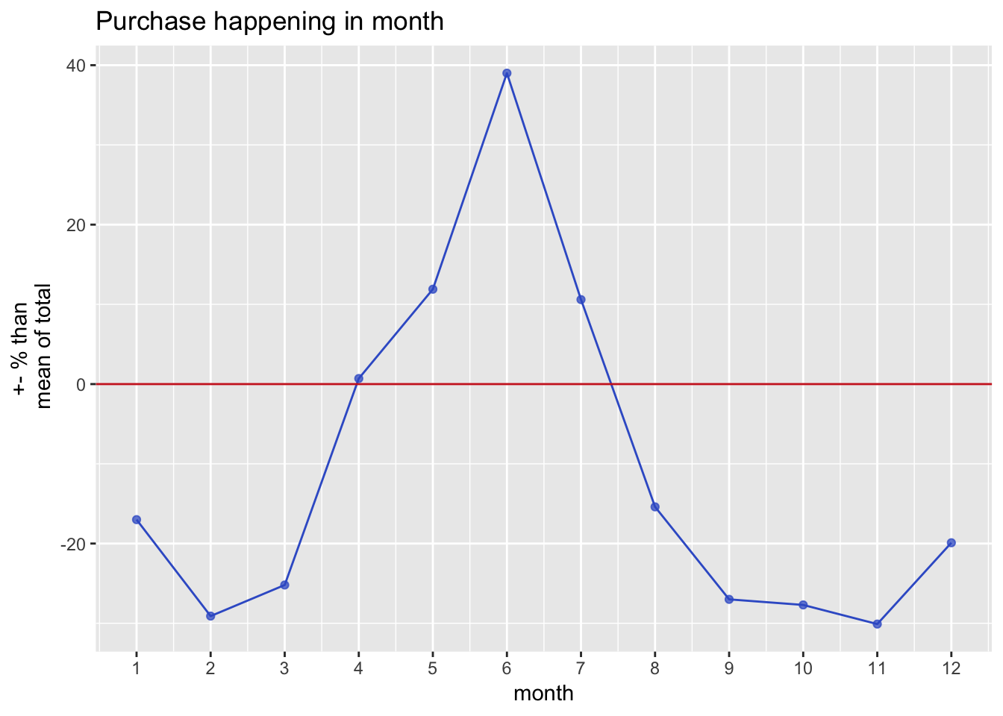
Seg4: 10% size,9.01% revshare, Hood Rich
Month mean In %
nov-30.1
feb-29.1
jun+39
Other
Mean in %
womens_dept_spend-16.4
accessories_spend-26.8
internet_spend+70.9
Response-18.5
All
normality in %
2nd internet spend (1.18),
3rd retained spend,
7th hhincome(65889)

Slide 7
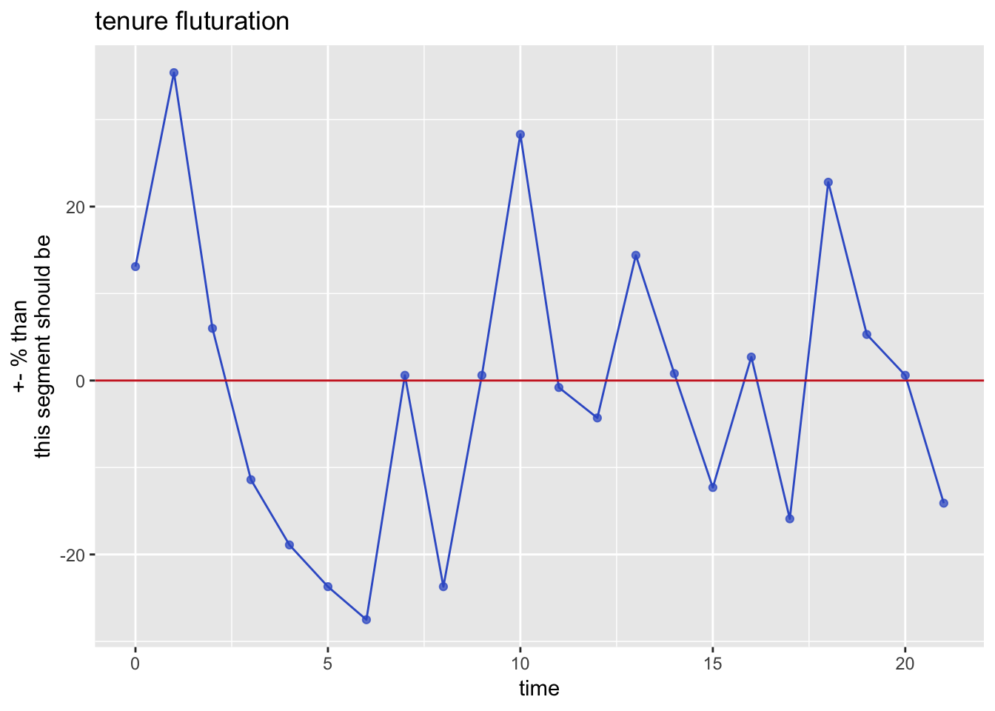
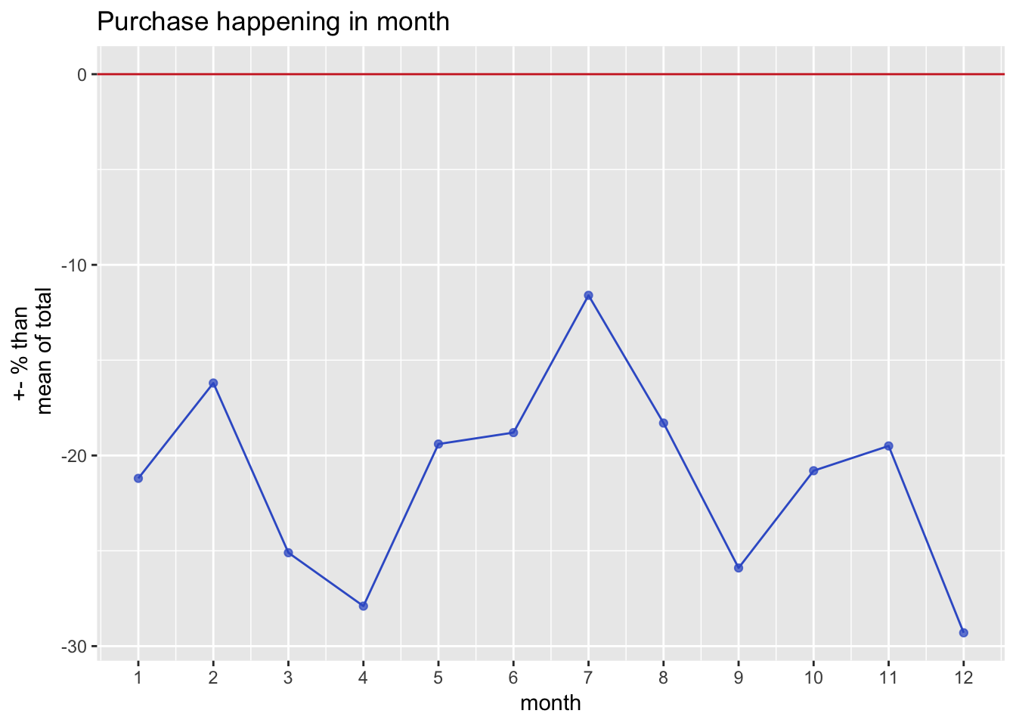
Seg6: 12.8% size, 16.34% rev share, Personal Shopper
old lady, kids carer, visit the most, buy more unique size, visit few, response much
Oldest(36.87),
1st spend total,
1st women_dept_spend,
1st kid_dept_spend,
1st athletic_dept_spend,
1st accessories_spend,
1st response(twice than 2nd ),
1st total transactions,
1st total items,
1st unique sizes(2.84),
1st unique dept(2.33),
1st tenure,
1st retained spend,
1st pct_response(0.16),
1st hhwoman(1.61),
1st hhincome(73941)
Other
Mean in %
total_spend -21.6
mens_dept_spend -10.8
womens_dept_spend-23.6
kids_dept_spend-20
athletic_dept_spend-22.4
accessories_spend-28.6
Response48.4
total_txns -23.4
total_items -24.3
unique_depts-11.6,

Slide 8
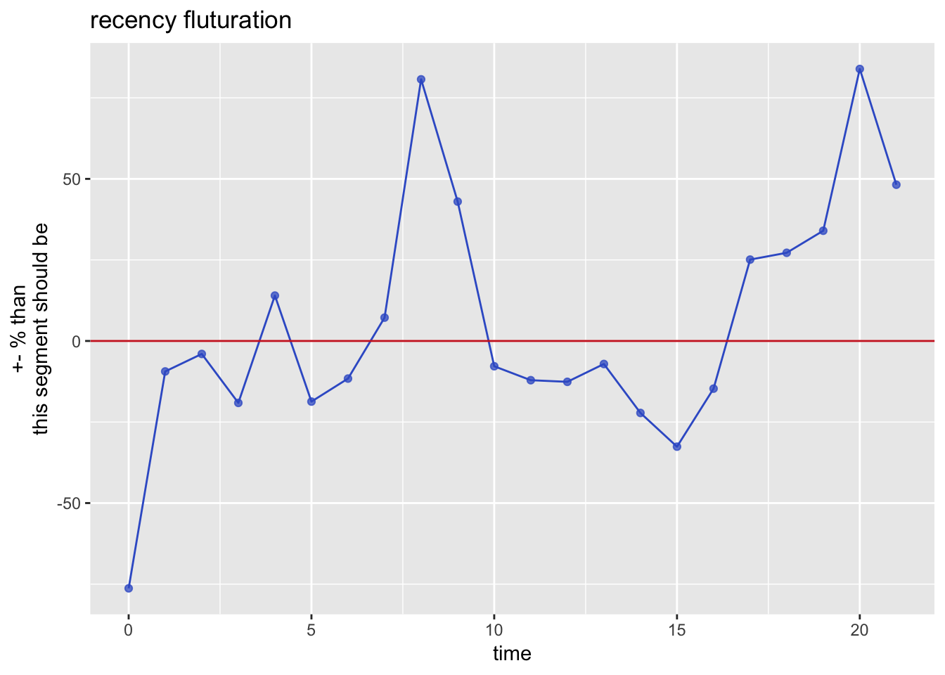
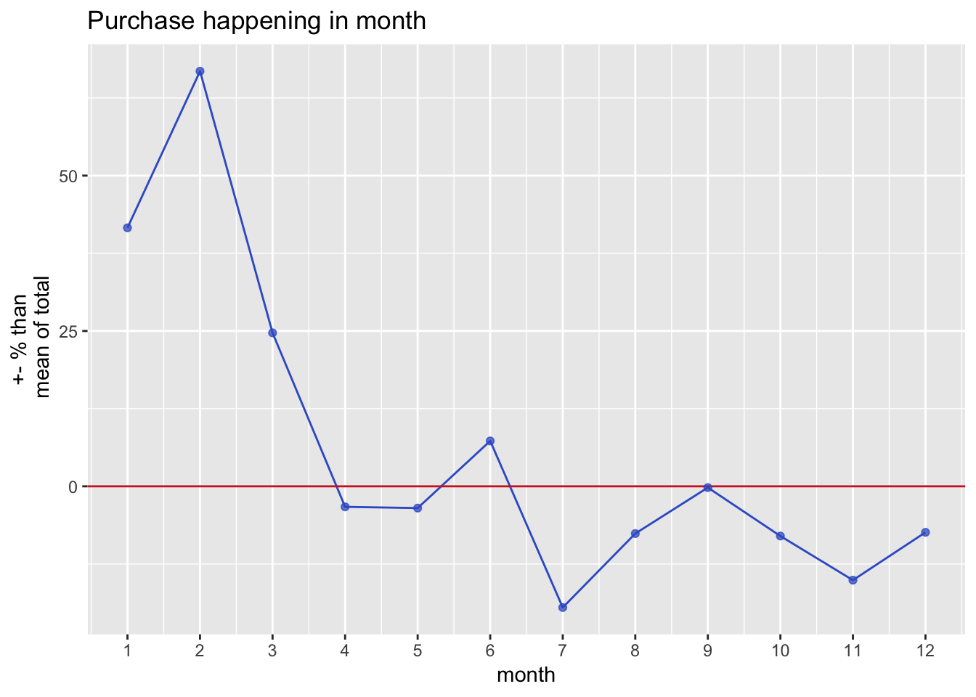
Seg7: 10.5% size,11.13% revshare, Be My Valentine
don’t shop online,
Other
Mean in %
internet_spend -71.2
kids_dept_spend +17.1
Response +10.5
2nd old(34.54)
1st hhkids,
2nd kid_dept_spend,
2nd athletic_dept_spend,
2nd accessories_spend,
2nd total transactions,
2nd total items,
2nd unique sizes(2.56),
2nd unique dept(2.13)
7th internet spend(0.2),
2nd tenure,
2nd retained spend,
2nd pct_response(0.11),
2nd hhwoman(1.61),
2nd hhincome(69136)

Slide 9
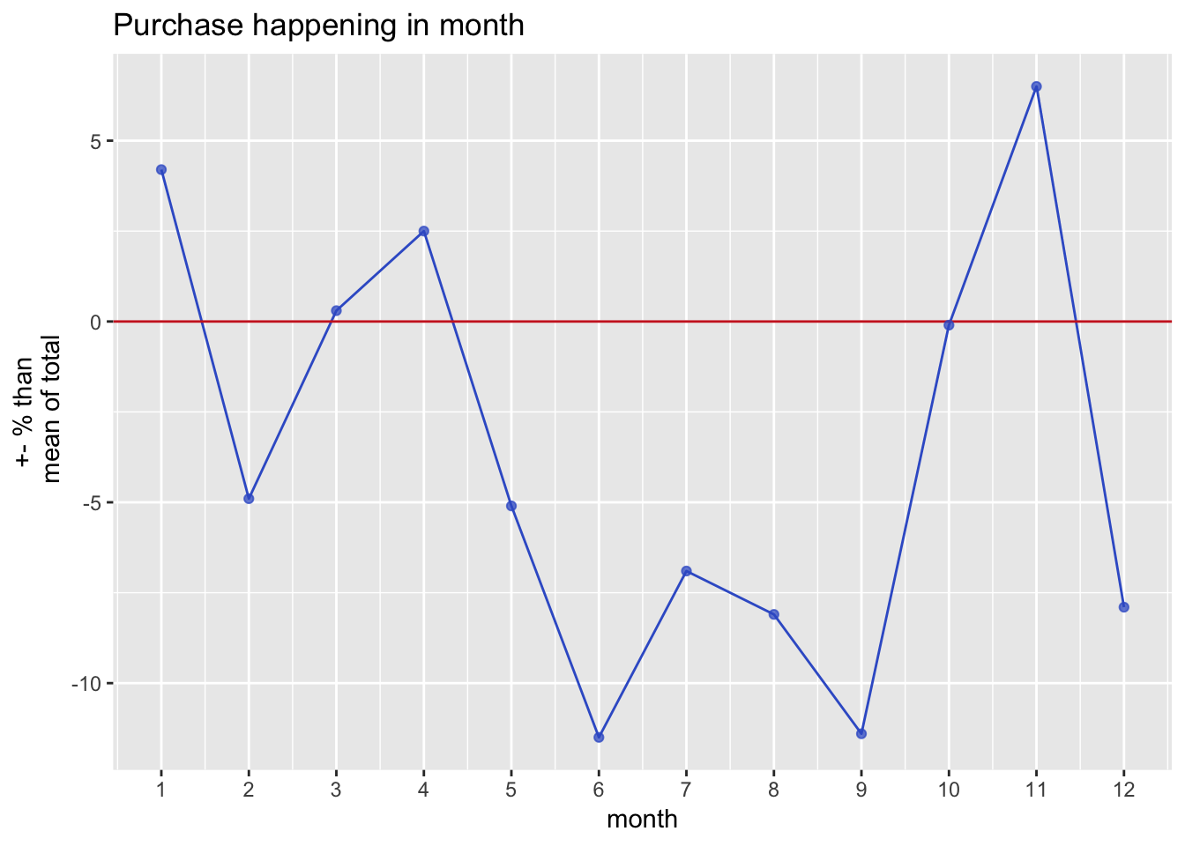
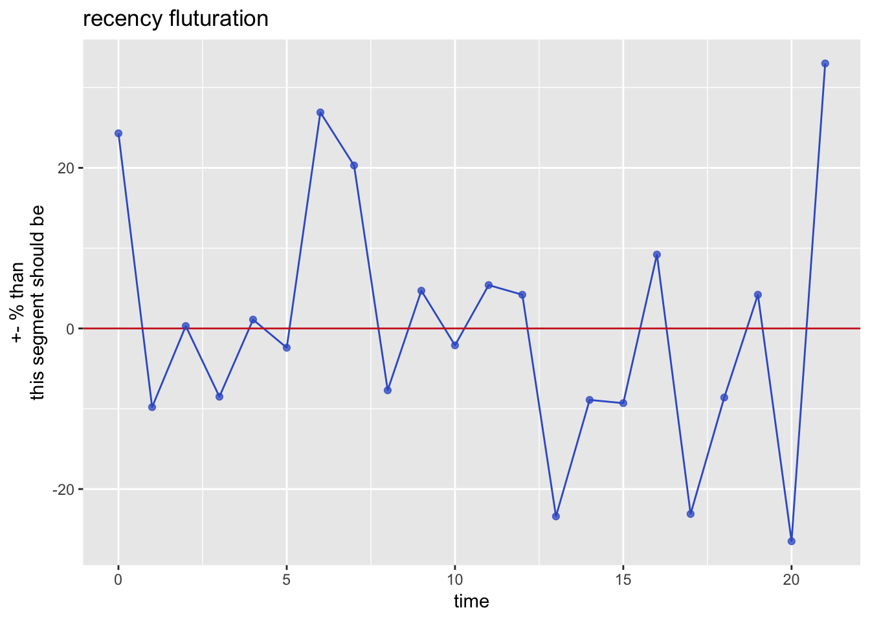
Seg5: 24.1% size, , 22.15% rev share, Coal for Christmas
Month mean In %
Other
Mean in %
kids_dept_spend -11.2
Response -17.5
total_items -10
ever_responded -11.8
kids_dept_buy -10.8
6th hhincome(67128)

Slide 10
Woman spend much more than man PPL spend the fewest on kids all segements buy 2+ sizes opens and clicks are variant small(0.065, 0.009) range of hhincome=8052 range of age=3.5 hhwom>>hhmen (1st – 1st =0.6) wom_dept_buy>>man_dept_buy (1st-1st =0.36) man_dept_buy== kids_dept_buy athletic_dept_buy> wom_dept_buy (1st – 1st = 0.052)

Slide 11
WHAT SEGMENT SHOULD WE ATTACK?
Why?
Through What Vehicle(s)?
DESIGN A TEST AND LEARN PLAN
CREATE CATEGORY MANAGEMENT STRATEGY

Slide 12

Shoe Store
Segment
Analytics

Slide 13
Agenda
1
Executive Summary
Outline of our customers
Categorical Management
2
Outline of each segments
Segments Profile
3
Including suggested strategy
Test & Learn
4
Reference
5

Slide 14
Executive Summary
01
Women WON!
02
Kids?
03
Fit and beat!
Women department is generating 238% sales than men department
Kids department only generate 18.5% sales size of women department
Athletic department has the 1st sales, which is 161% size of women
04
Fatigue?
05
Utopia!
06
Party!
Only 0.9% of our MARCOMs are clicked
The range of household income is only $8052
All 7 segments perform at least 18% better than normal during some holidays.

Slide 15
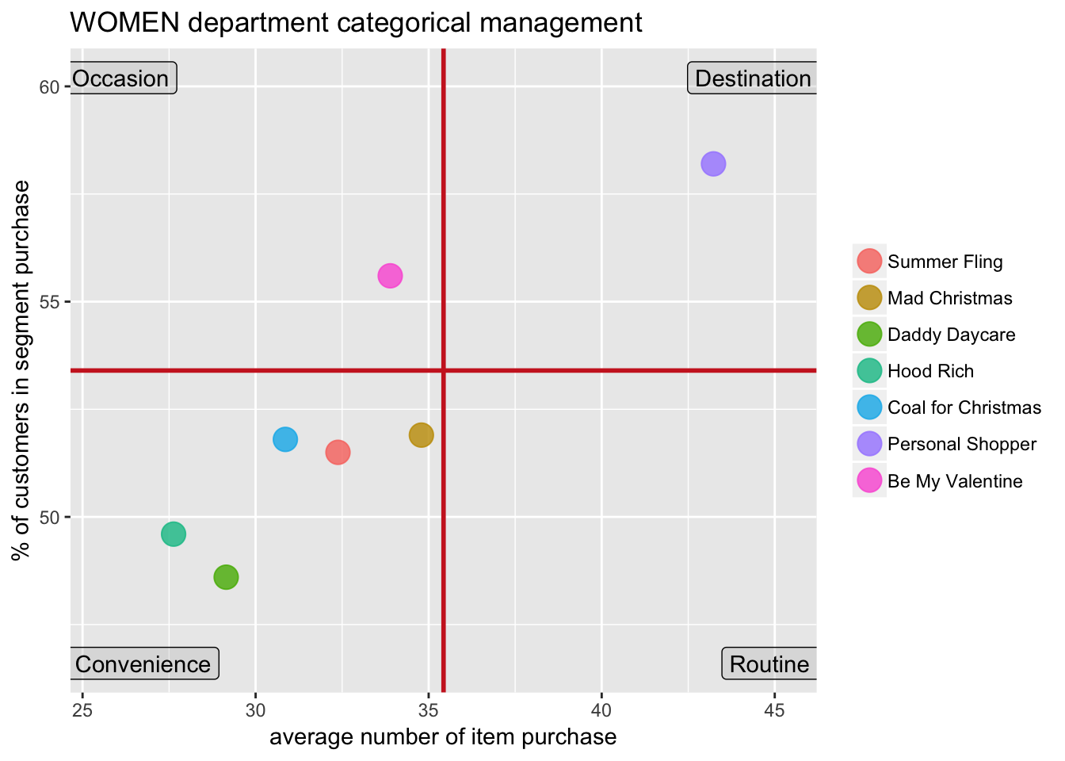
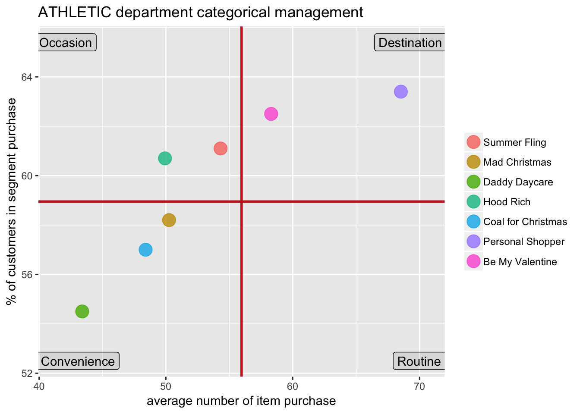
Categorical Management

Slide 16
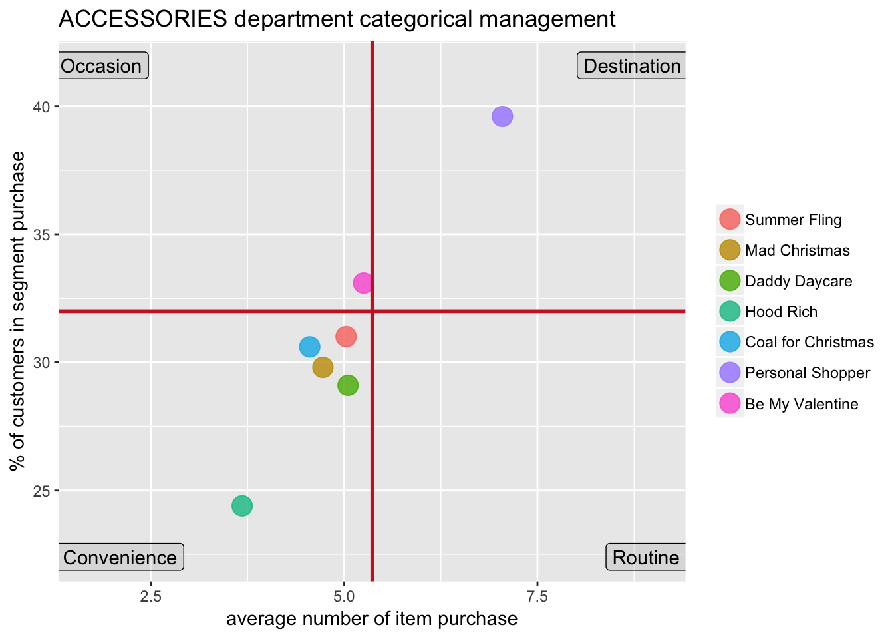
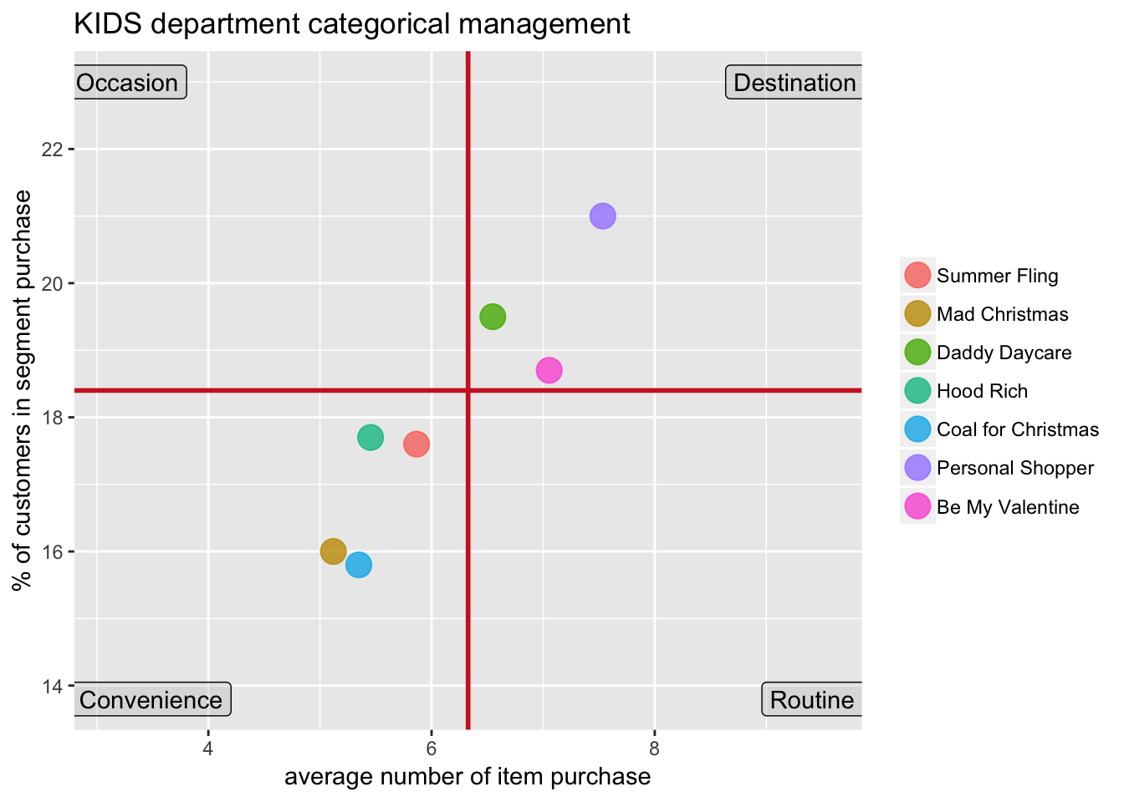
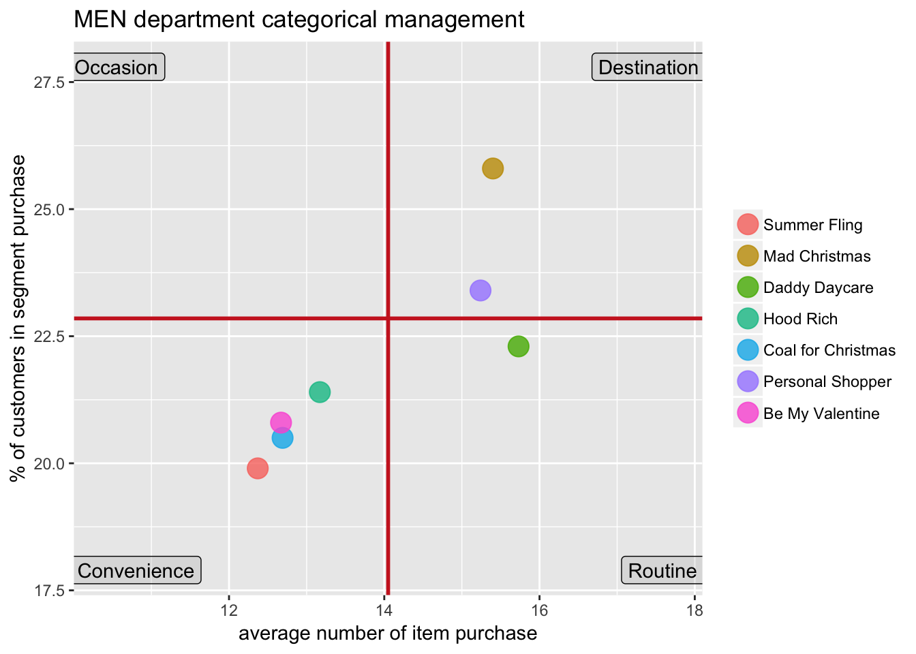
Categorical Management

Slide 17
Segment Size
12.8%
10.5%
21.8%
Personal Shopper
Be My Valentine
Summer Fling
16.34%
11.13%
21.64%

Slide 18
Segment Size
24.1%
10%
9.8%
10.9%
Coal for Christmas
Hood Rich
Daddy Daycare
Mad Christmas
22.15%
9%
8.86%
10.85%

Slide 19
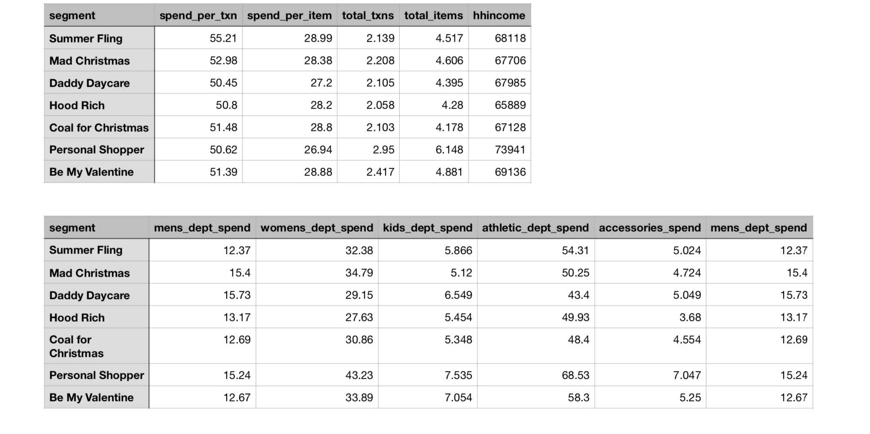
Highlighted Mean

Slide 20
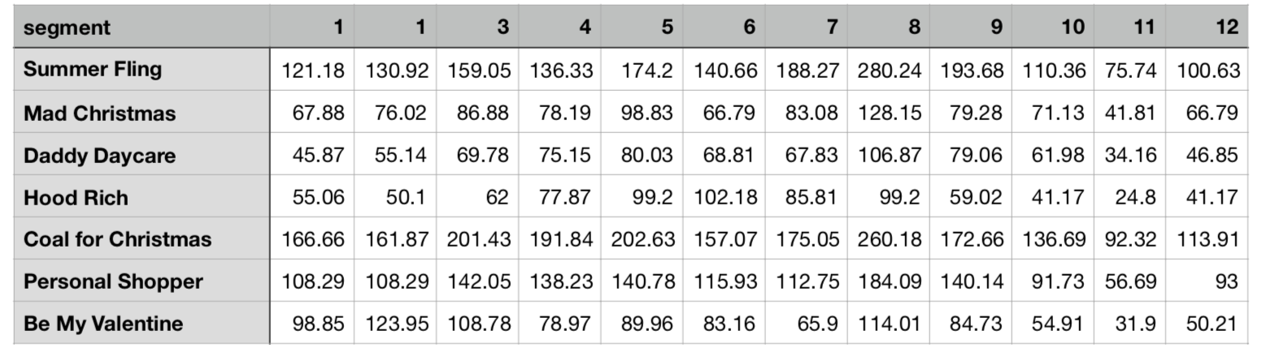
Number of Visit in each month

Slide 21
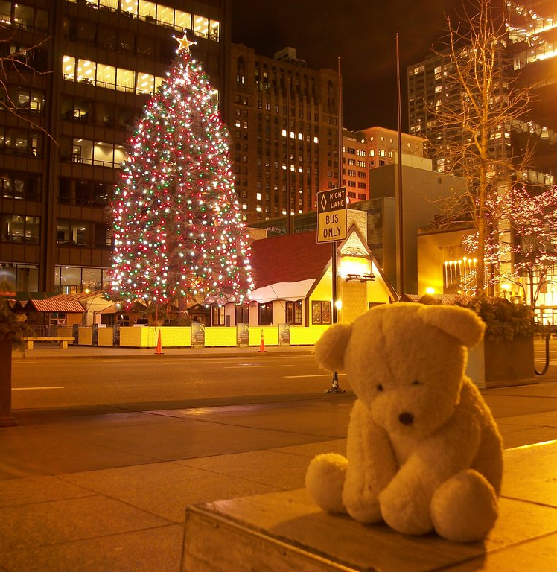
Coal for Christmas
6th Household Income ($67128)
11.2% less likely spend on kids products
17.5% less likely response to MARCOMs
Visiting peaks are at New Year and Thanksgiving

Slide 22
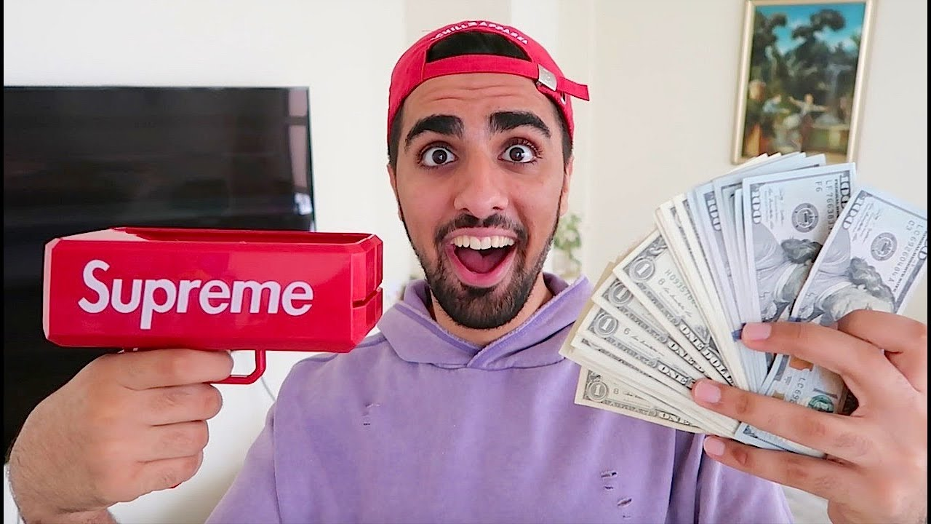

Hood Rich
Fewest Household Income
Youngest!
71% more likely purchase on internet
Highest chance open our MARCOMs

Slide 23
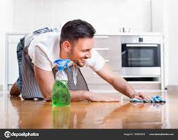

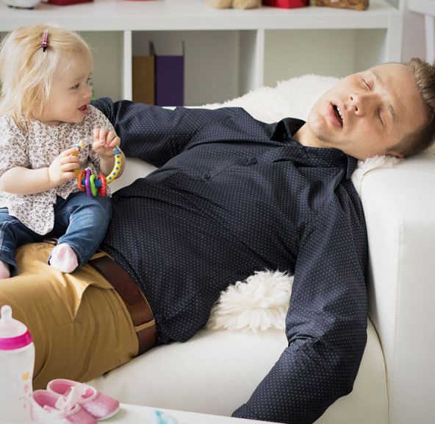
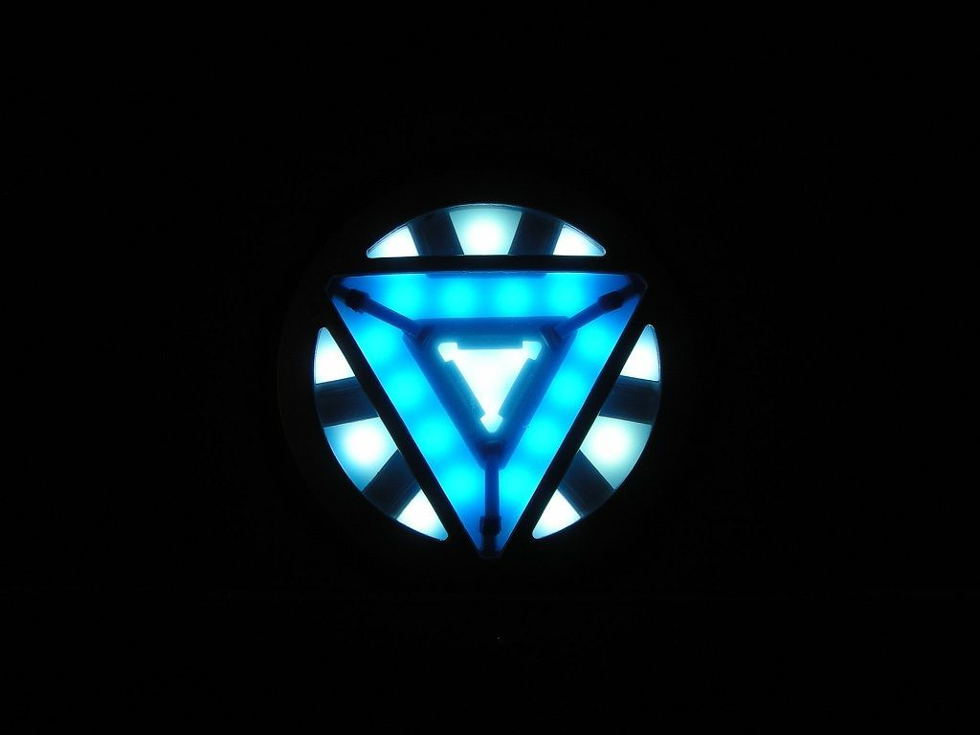
Daddy Daycare
1.32 kids at home
18.4% less likely purchase athletic products
Fewest women at home
Spend the most on
Men products

Slide 24
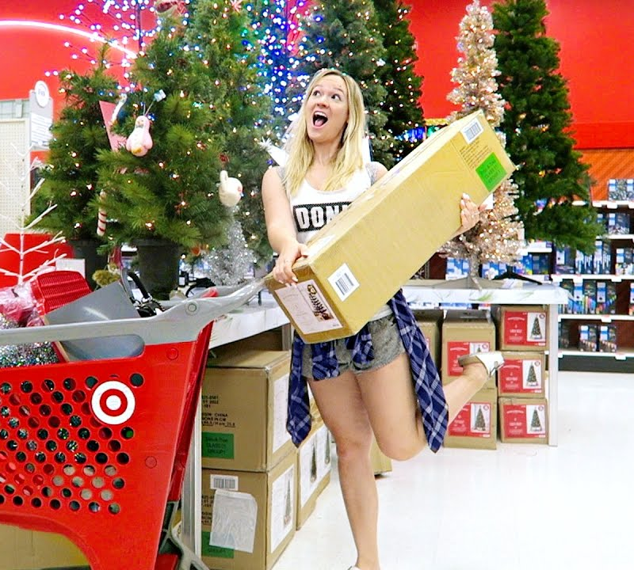
Mad Christmas
Visiting peaks are around Christmas
Spend the 2nd most both on women and men products
Average spending is, again, the 2nd
Spend the most on the Internet

Slide 25
Summer Fling
ALL summer months are their visiting peaks
Average spending is highest
Per item price is the highest
They are communicated fewest

Slide 26

Personal Shopper
No.1 Spending in all categories, except men
Highest response rate, twice higher than 2nd
They buy the most various sizes (2.9)
Highest total transactions and items, but visit fewest
No obvious seasonality

Slide 27

Be My Valentine!
Target Segment
Now, which segment we are going to attack?

Slide 28
Not Online
Only 20% of chance shopping Online
2nd
Items #
Transactions #
AccessoriesDept
AthleticDept
KidsDept
Share Joy
Who’s SHE?
Buy 2.56 unique sizes
10.5% of customer population
11.13% of total sales
34.5
Average Age
They are wealthy millennial moms,
spending big ticket on their life and kids.
The are fully potential since they share so much similarity
with Personal Shopper as far as buying behavior.
1.32
Average Kids at home

Slide 29
+25% purchase
+18382
sales
+33650 sales
Strategy
&
Return
Drop Price For 6%
Bundle athletic and accessory product
Customized Campaigns
They are sensitive to price, a 6% drop in price leads to 25% more transaction amount.
the price elasticity of this segment is 3.08
Purchasing accessory products increase the chance of purchasing athletic product by 141.3%
They are 2nd frequently communicated by campaigns and hardly shop online, so some offline campaigns are the must!

Slide 30

THE ABOUT
Pick out 50 customers randomly in segment
Test & Learn
Send these customers special coupons
5% off / products bundle
Track them for 3 months, test their transaction with regression
To check if the price elasticity and bundle strategy are correct
If correct, push this strategy to whole segment.

Slide 31
Warren Wang
YOUR CLASSMATE
If you’re not having fun with what
you’re doing then you’re doing it wrong.

